Slide 1
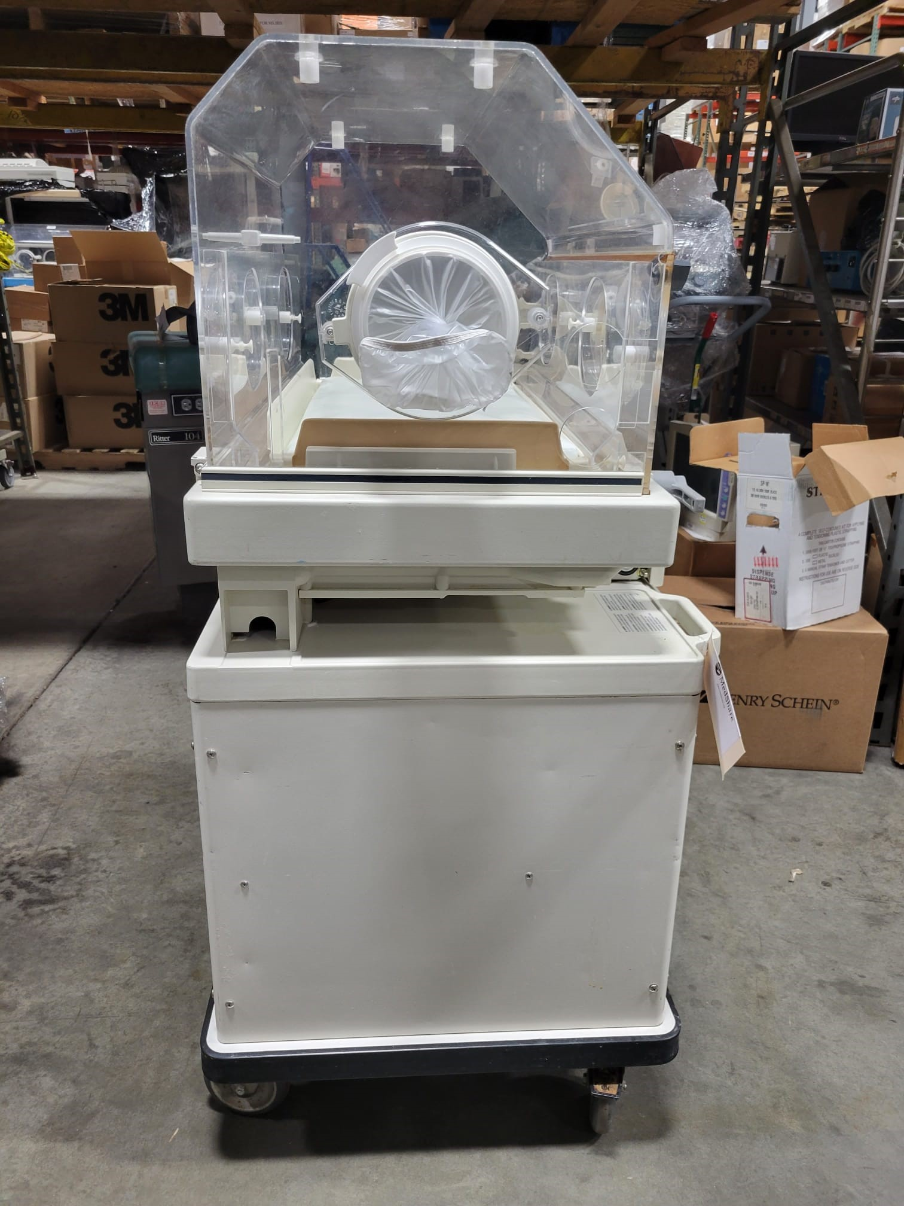
Baby incubator
Approximately: $TBD.00
PLEASE HELP
Zelle: info@ngemba.org
CashApp: $ngembageorgia
Venmo: @Ngemba-CulturalAssociation

Slide 2
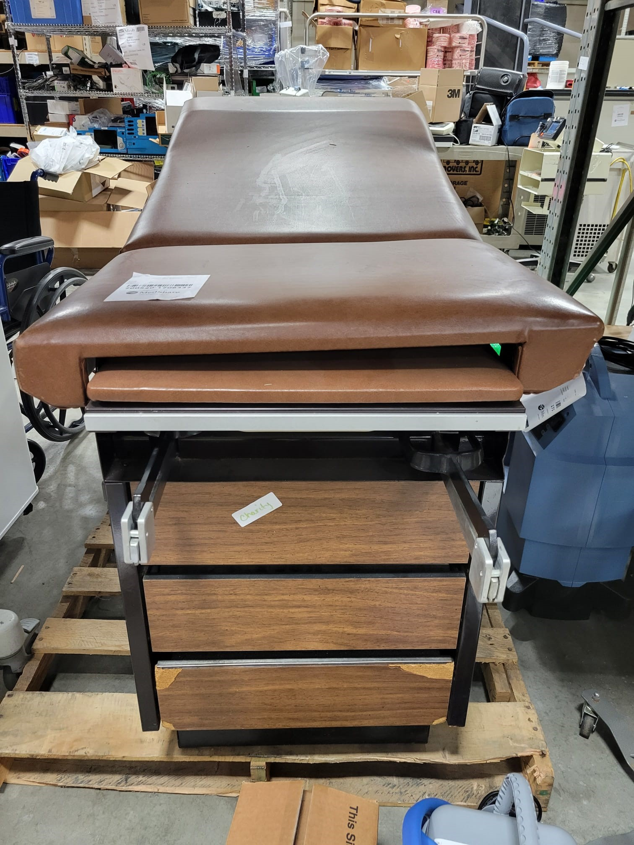
Gynecological examination table
Approximately: $1,500.00
PLEASE HELP
Zelle: info@ngemba.org
CashApp: $ngembageorgia
Venmo: @Ngemba-CulturalAssociation

Slide 3
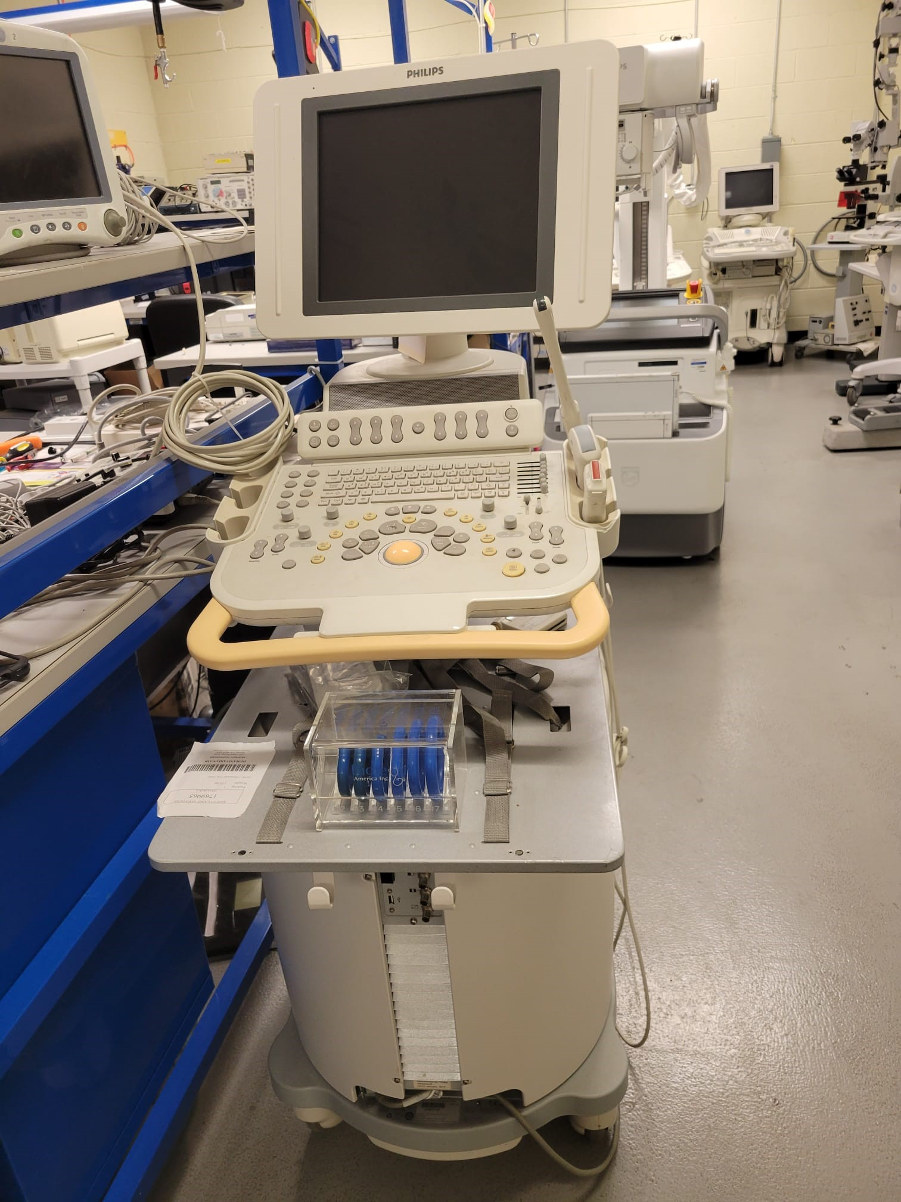
Ultrasound machine with probes
Approximately: $ TBD.00
PLEASE HELP
Zelle: info@ngemba.org
CashApp: $ngembageorgia
Venmo: @Ngemba-CulturalAssociation

Slide 4
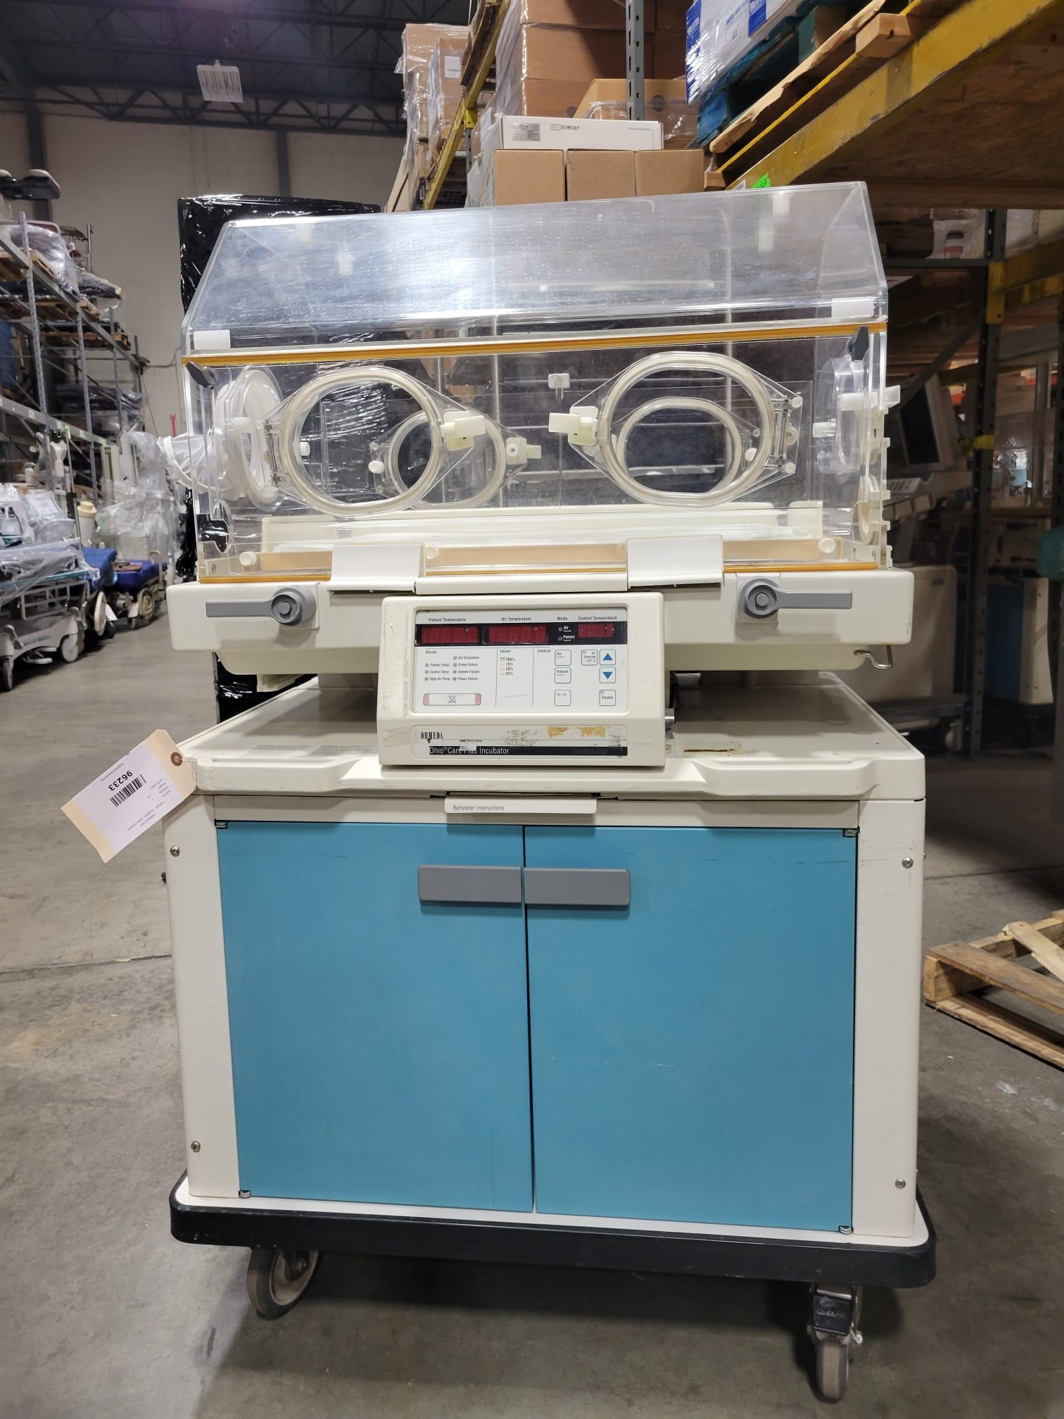
Baby incubator
Approximately: $3,000.00
PLEASE HELP
Zelle: info@ngemba.org
CashApp: $ngembageorgia
Venmo: @Ngemba-CulturalAssociation

Slide 5
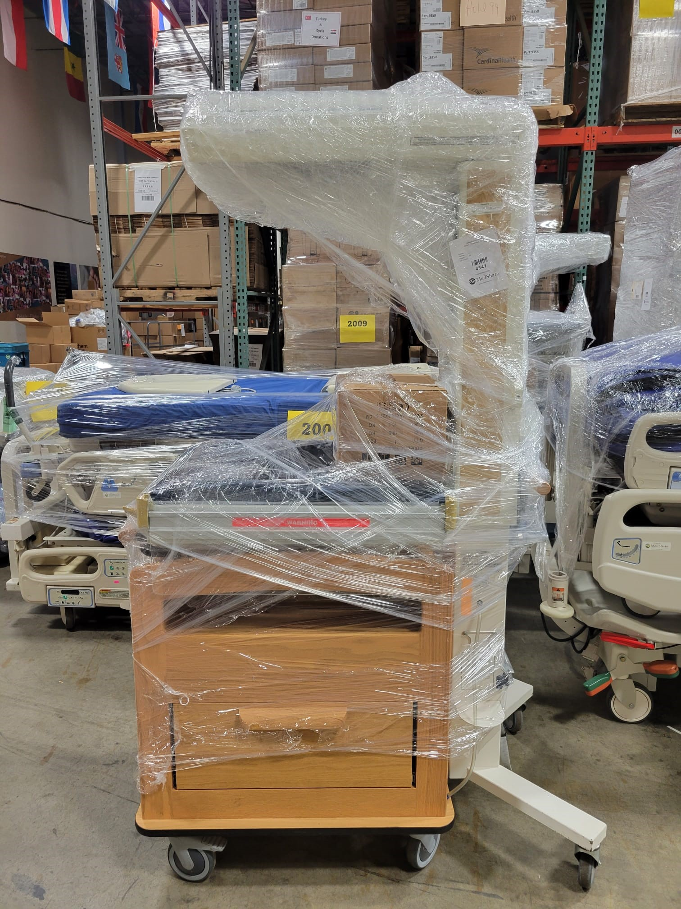
Infant warmer with basinet
Approximately: $3,500.00
PLEASE HELP
Zelle: info@ngemba.org
CashApp: $ngembageorgia
Venmo: @Ngemba-CulturalAssociation

Slide 6
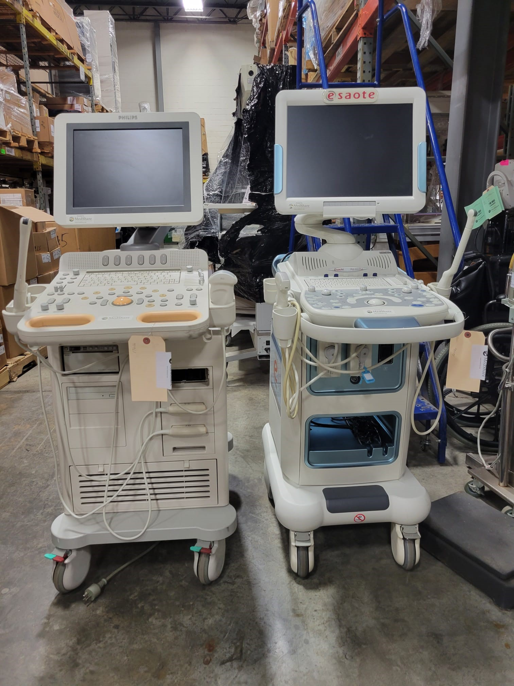
Ultrasound machines with probes
Approximately: $9,000.00
PLEASE HELP
Zelle: info@ngemba.org
CashApp: $ngembageorgia
Venmo: @Ngemba-CulturalAssociation

Slide 7
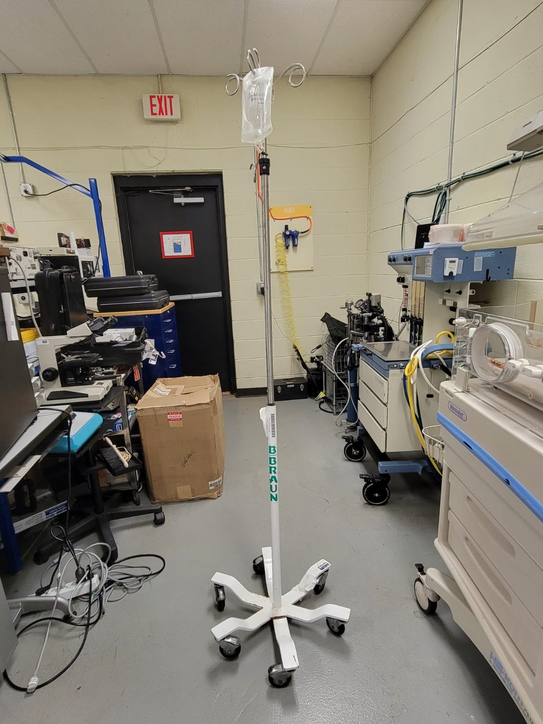
An iv pole
Approximately: $150.00
PLEASE HELP
Zelle: info@ngemba.org
CashApp: $ngembageorgia
Venmo: @Ngemba-CulturalAssociation

Slide 8
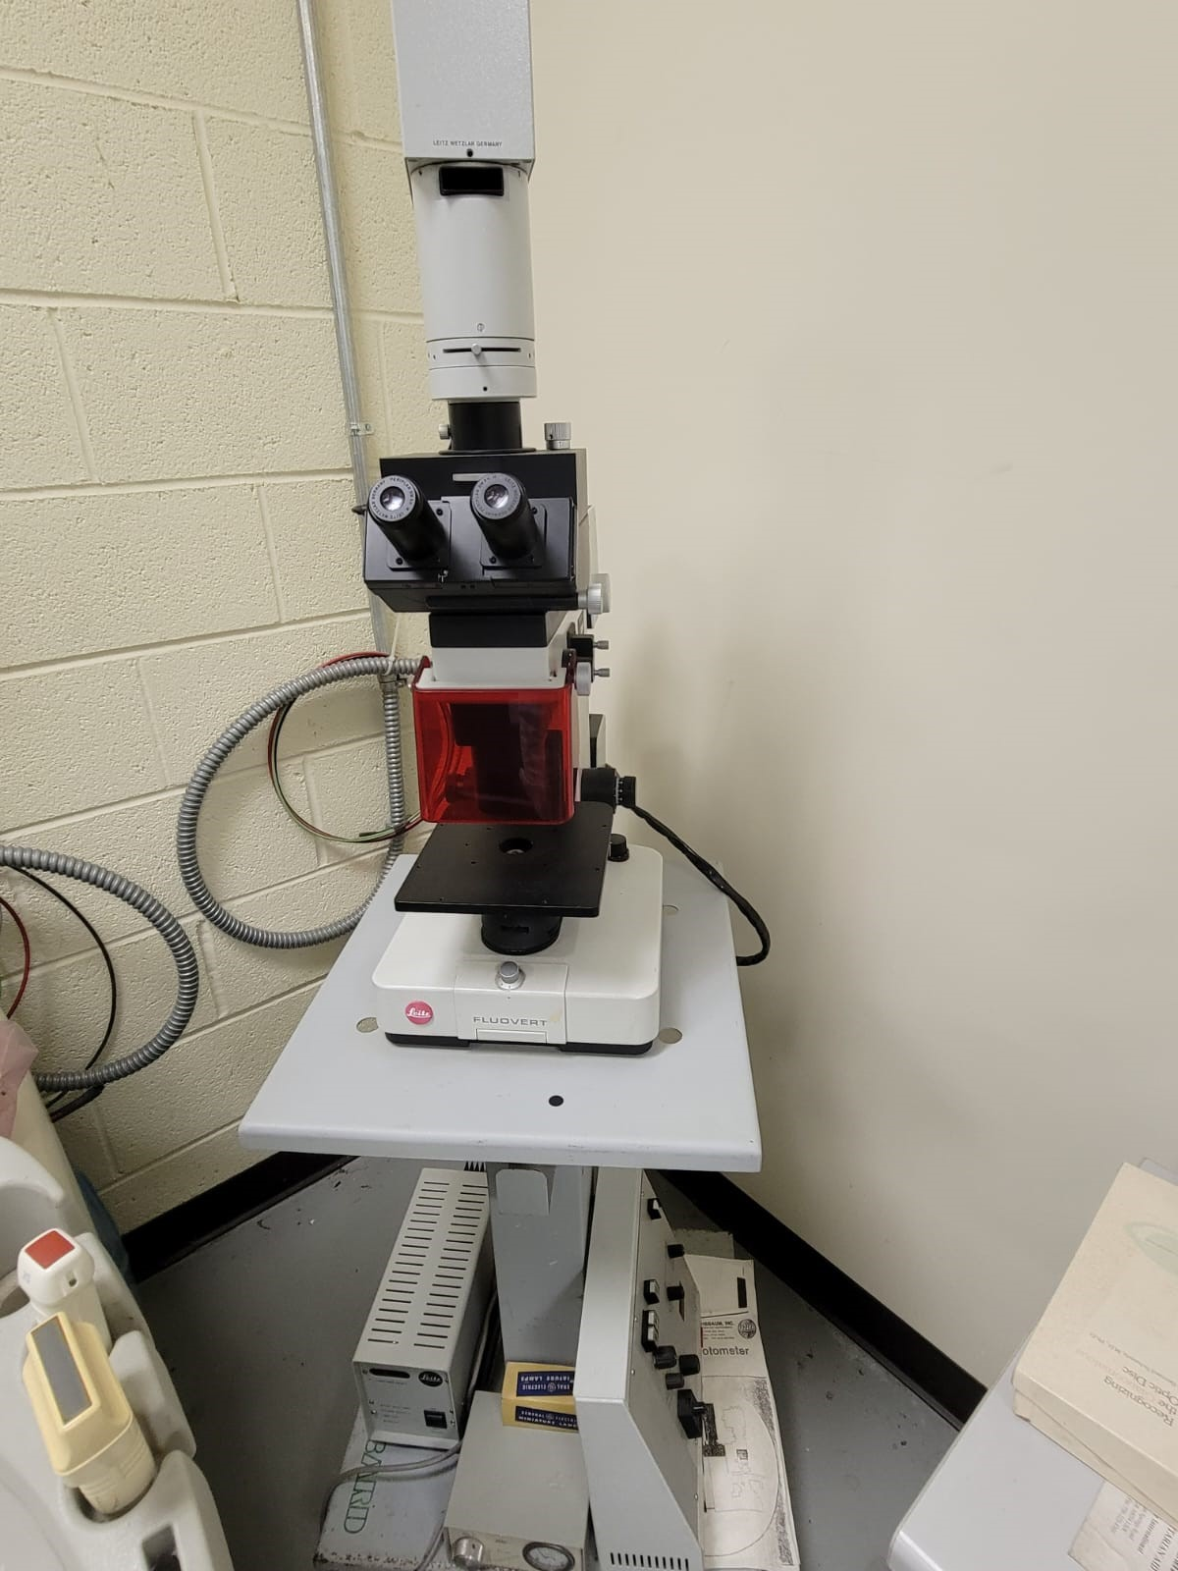
Trinicular led microscope
Approximately: $1700.00
PLEASE HELP
Zelle: info@ngemba.org
CashApp: $ngembageorgia
Venmo: @Ngemba-CulturalAssociation

Slide 9
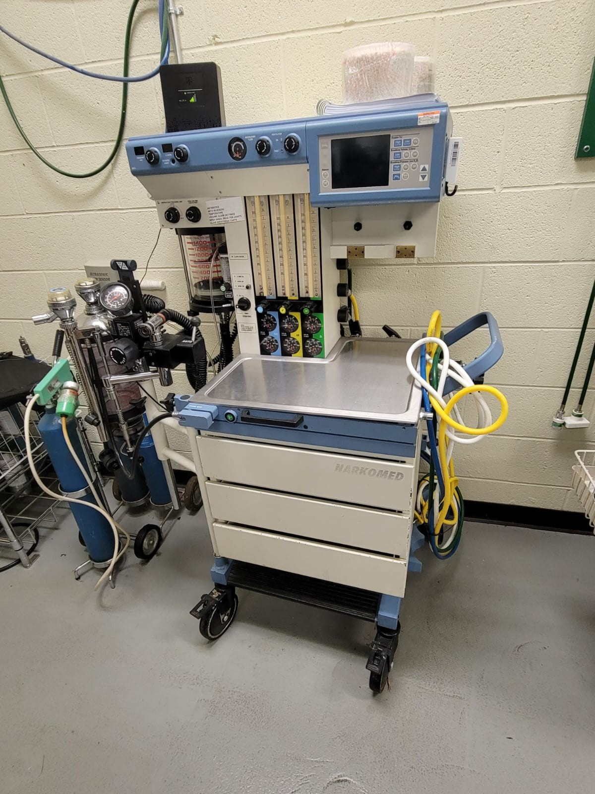
Anesthesia machine
Approximately: $10,000.00
PLEASE HELP
Zelle: info@ngemba.org
CashApp: $ngembageorgia
Venmo: @Ngemba-CulturalAssociation

Slide 10
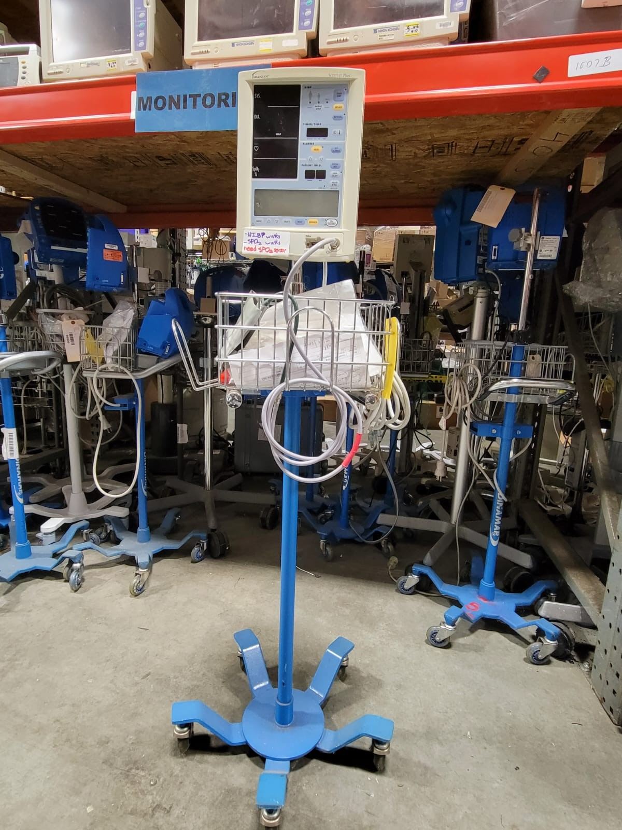
Ultrasound machines with probes
Approximately: $9,000.00
PLEASE HELP
Zelle: info@ngemba.org
CashApp: $ngembageorgia
Venmo: @Ngemba-CulturalAssociation

Slide 11
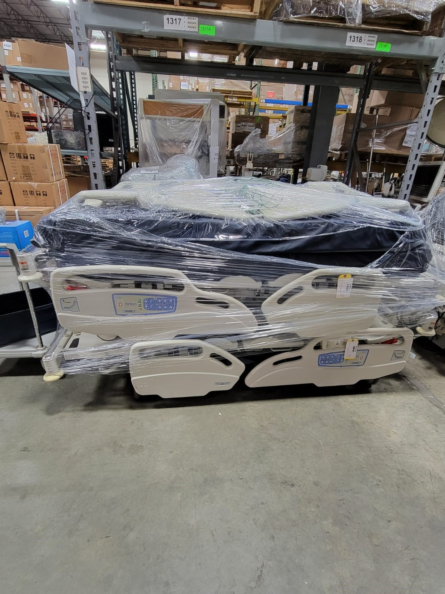
Hill-room bed
Approximately: $4,000.00
PLEASE HELP
Zelle: info@ngemba.org
CashApp: $ngembageorgia
Venmo: @Ngemba-CulturalAssociation

Slide 12
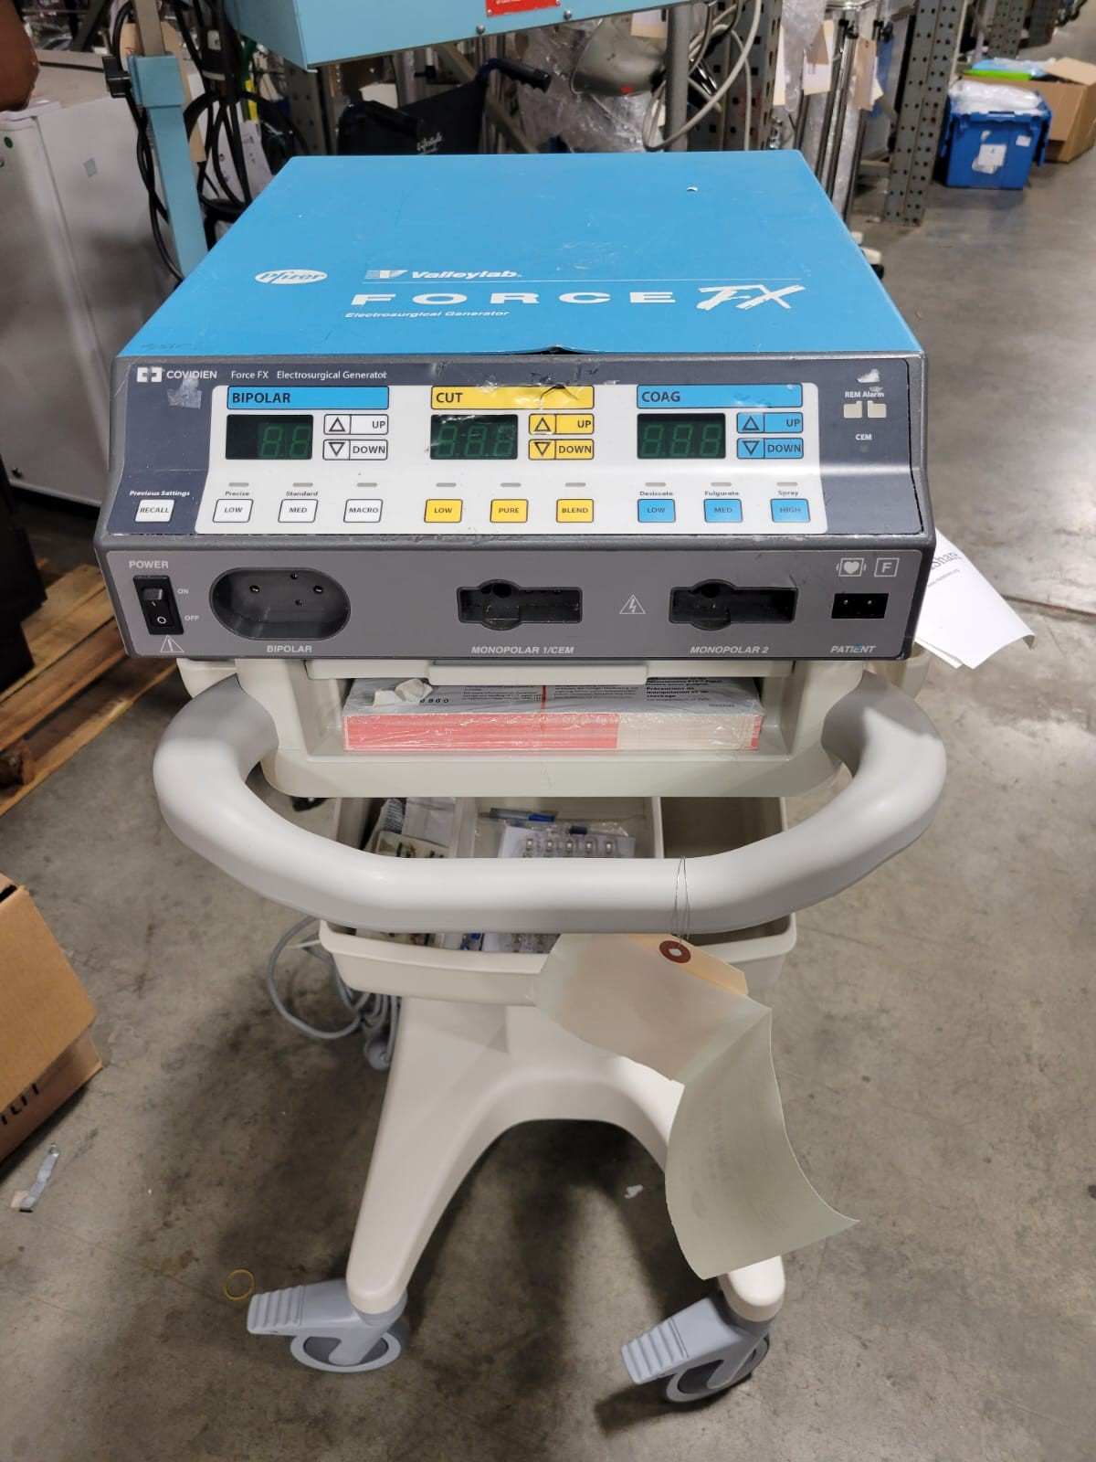
Electrosurgical unit
Approximately: $4,000.00
PLEASE HELP
Zelle: info@ngemba.org
CashApp: $ngembageorgia
Venmo: @Ngemba-CulturalAssociation

Slide 13
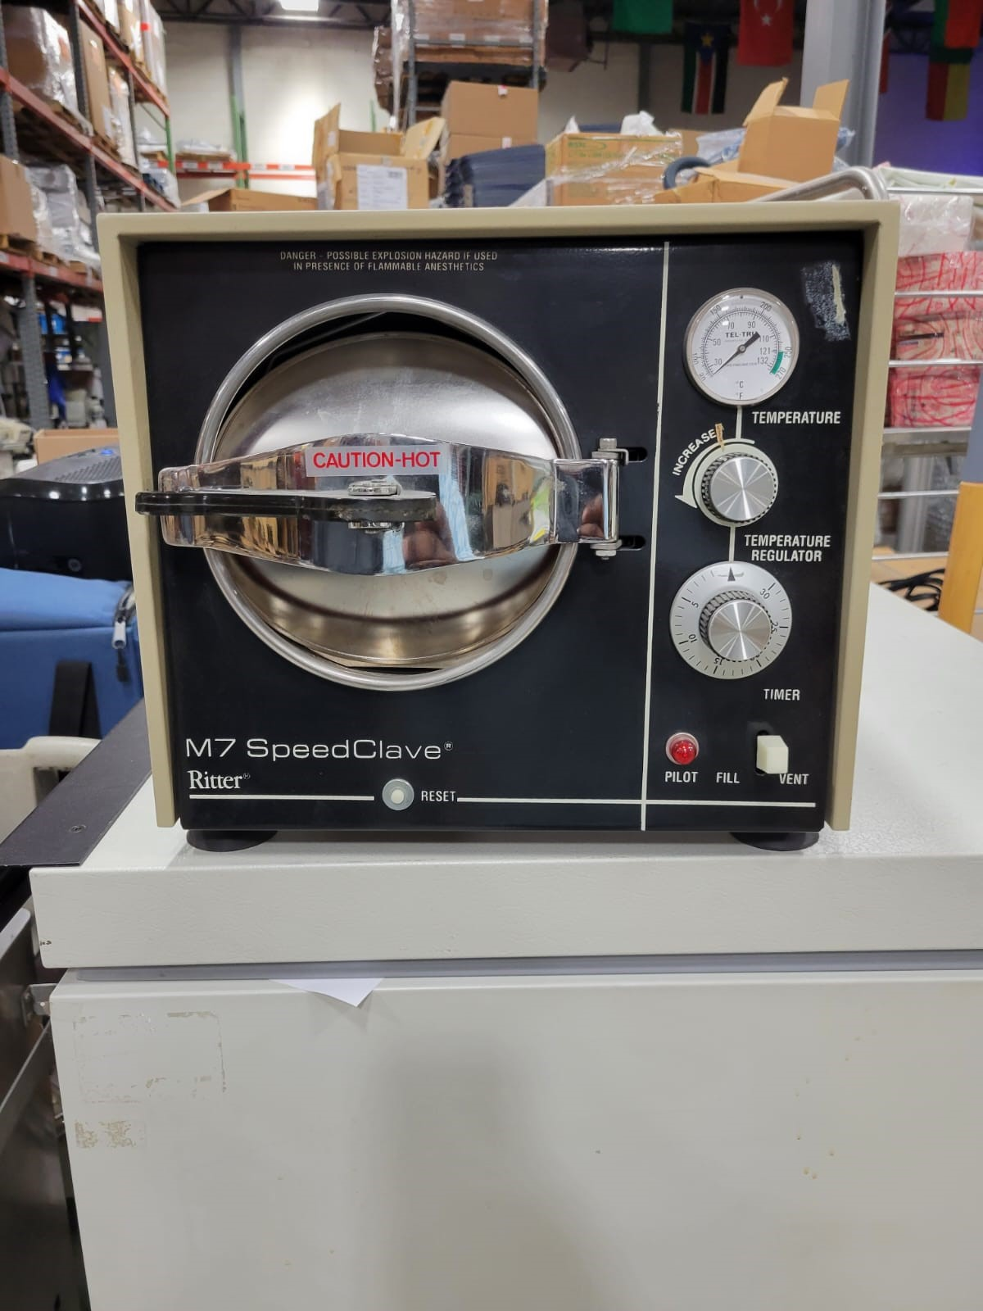
autoclave
Approximately: $1,300.00
PLEASE HELP
Zelle: info@ngemba.org
CashApp: $ngembageorgia
Venmo: @Ngemba-CulturalAssociation

